Slide 1

Data Science project
Tal Tzabari

Slide 2
Can We predict the score a movie will get on “imdb”?

Slide 3
Introduction
After searching the web for data-bases and failing to find a reliable one, and after trying to find a data-base with information I would like to research about, only to find out there is very little known about video games revenue online, I decided to use the data of IMDB as my data-base.
I haven't made this choice because it was the easy way out, I know from the assignments that the data-base is flowed and can’t reach a high R Squared value even with columns of numbers of likes added to it.
Before I decided that this is going to be my data-base, I made sure that it’s not a dead-end like the others. I looked around the information presented in each movie page, I knew revenue won’t be enough, then I found out that movie stars and directors had pages of information as well, only then I decided that I would use this data-base for my project.

Slide 4
My Process
Data Obtaining
Data Cleaning
EDA
ML
Evaluation

Slide 5
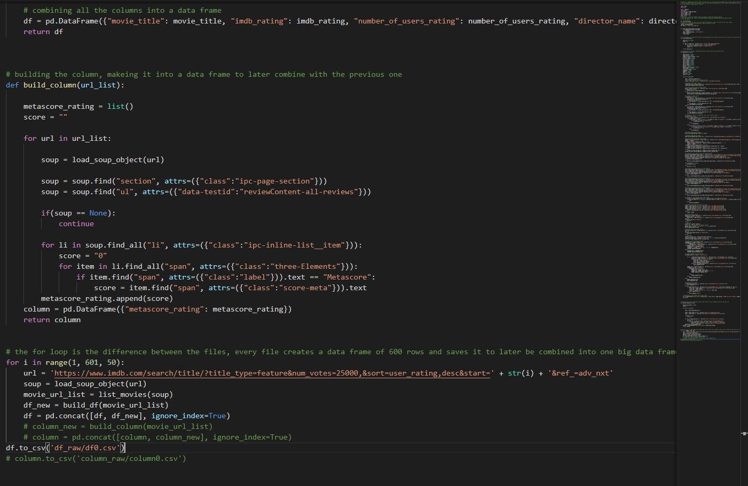
Data Obtaining - Crawling
I wrote a code using the libraries we learned in class in order to obtain the data from “imdb.com”.
My starting page is a list of 50 movies, there are 5610 movies on the list with 50 at every page (this is the list for movies with over 25K votes on them).
Because I kept opening pages, I ended up with an average time of 10 sec per row, this would have meant that my code would run for 15 hoars, so I created the same file 10 times and ran them simultaneously, this took about 2 hoars to complete, and when I ran into connection errors they weren’t as fatal.
Data Obtaining
ML
Evaluation
Data Cleaning
EDA

Slide 6
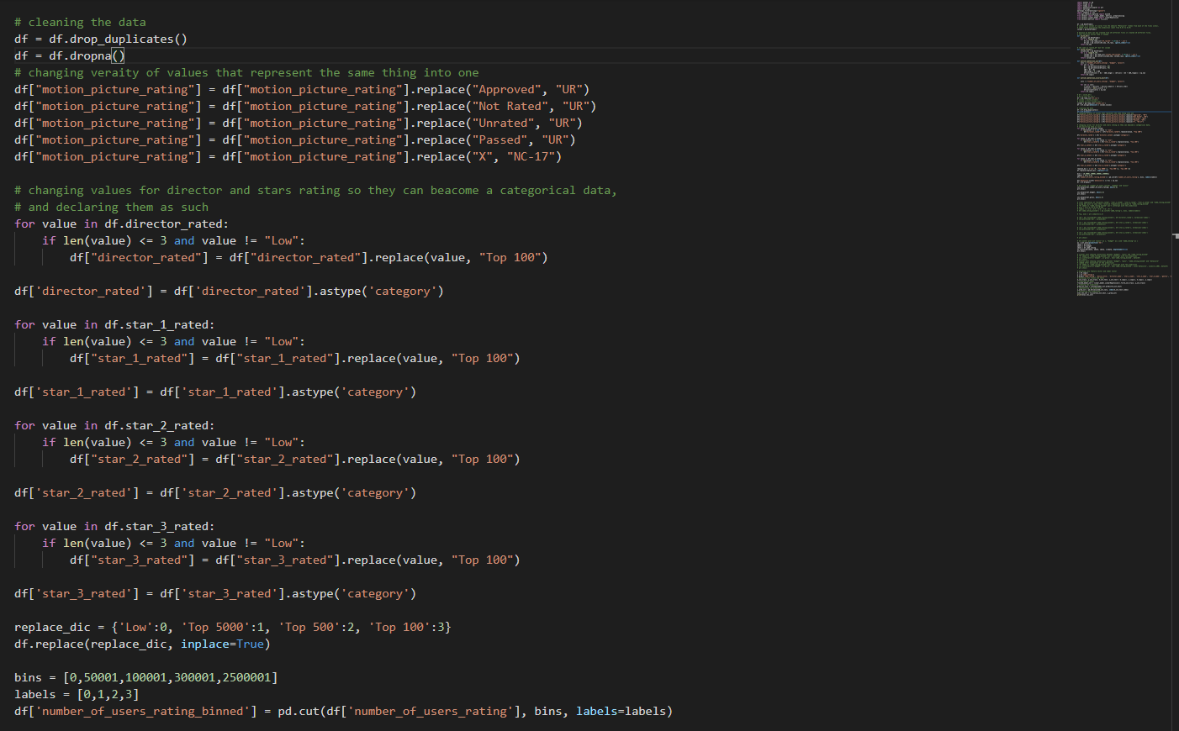

Data Cleaning
I removed duplicates and Nan values, my Nan values are only in budget and gross, so I removed all rows with Nan values with no conditions for better prediction.
I found that there are many ways to present Unrated in the parental guidance section, so I replaced them all with “UR”.
I declared the director and stars rating columns as categorical and changed the values to numeric, people in the top 100 were presented with their numbers so I replaced them with “Top 100” and replaced all the values with 0,1,2,3.
Data Obtaining
ML
Evaluation
Data Cleaning
EDA

Slide 7
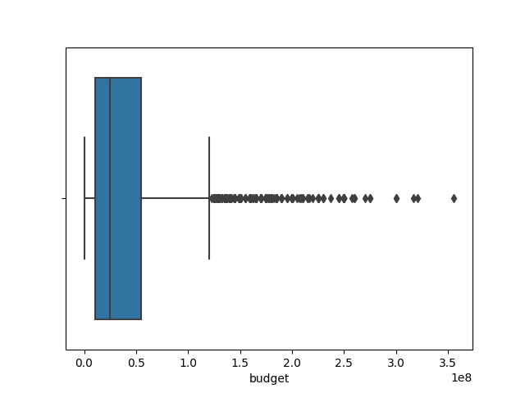
Data Cleaning - Outliners
Like we learned in the lesson about outliners, is it possible that someone paid 500$ for a ticket? In that case probably not but is it possible that a film has made a gross of 2.5B$? I think yes.
I fount outliners in all the numeric columns using both methods, but I believe those “outliners” are valid values.
But IMDB could have got false information and the number of voting users could be mixed with bots, so I kept an eye on the outliners at the prediction phase.
Outliners???
Data Obtaining
ML
Evaluation
Data Cleaning
EDA

Slide 8
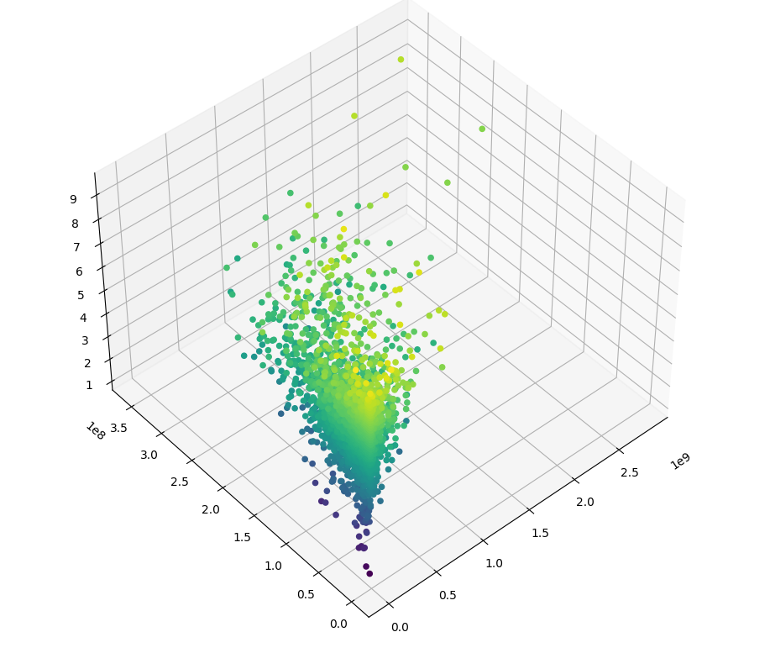
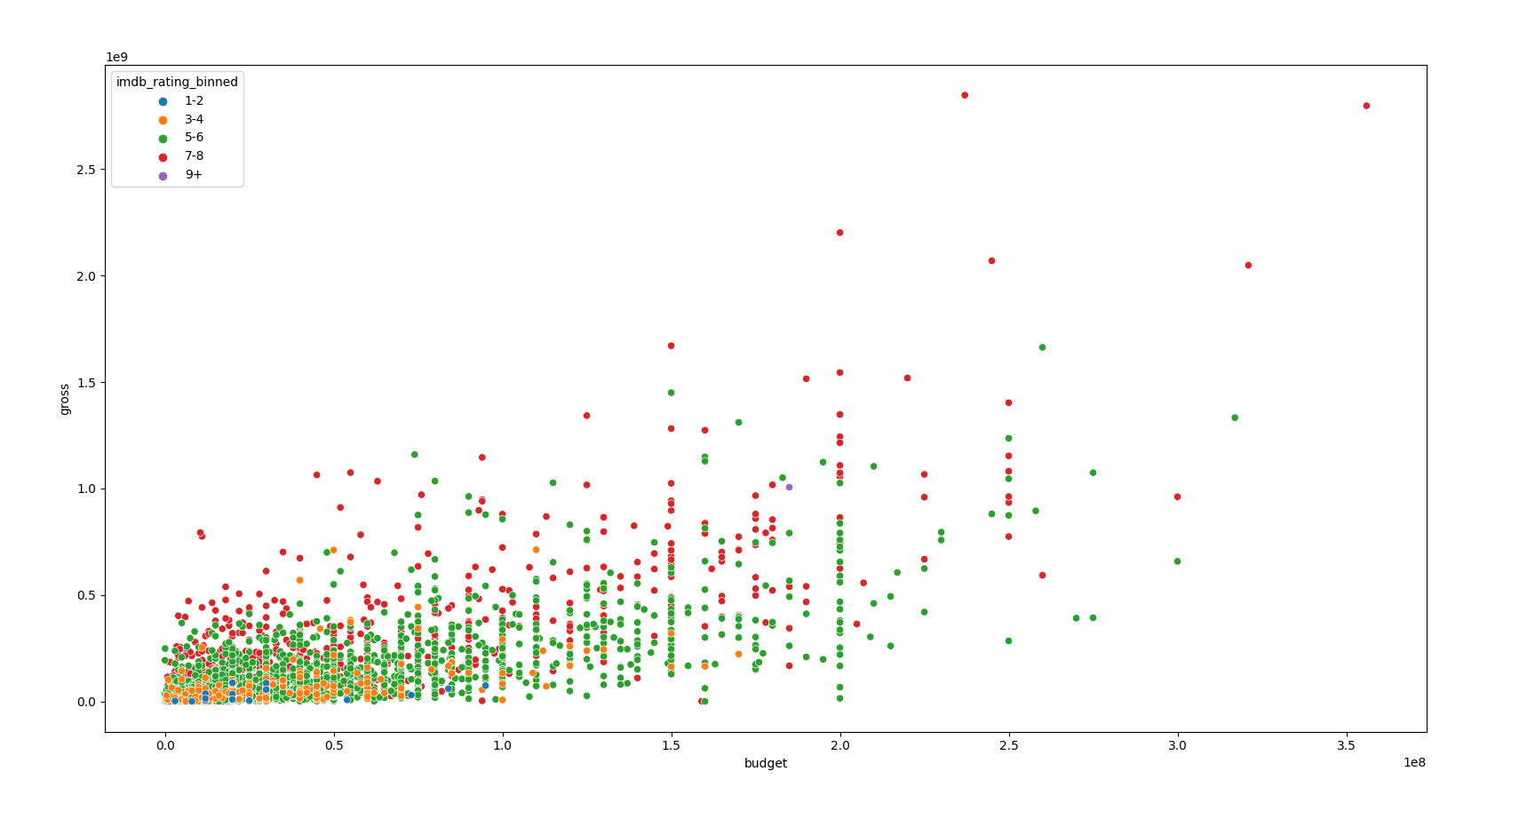
EDA – Gross, Budget And IMDB Rating
We can see there are films that have high budget and gross also have a high score.
But We also can see that a high score is not limited to those high-profile films.
We can find high IMDB rating in films that are more independence as well.
Data Obtaining
ML
Evaluation
Data Cleaning
EDA

Slide 9
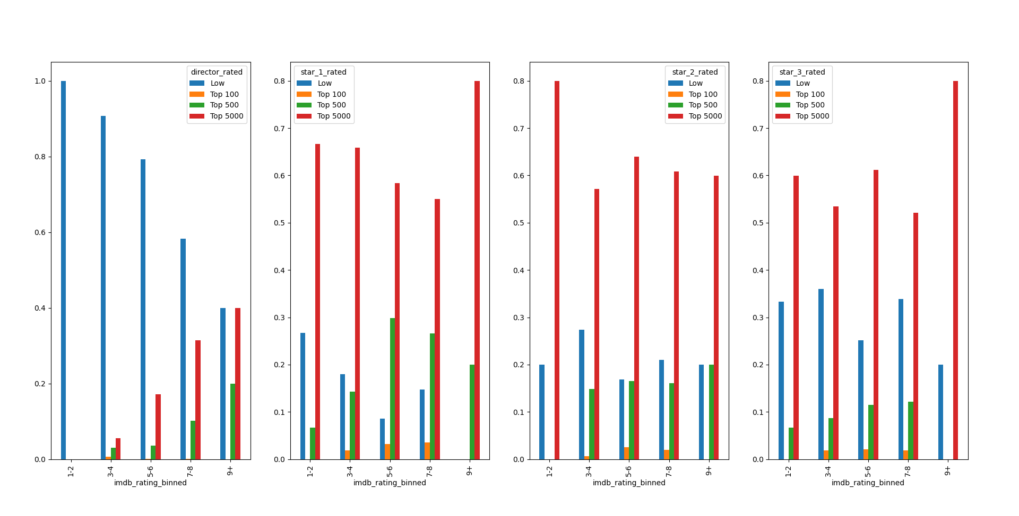
EDA – Director And Stars Rating And IMDB Rating (Binned), Relative Frequency
You should know that there are many famous movie stars that are placed in the “top 5000”, I believe that if I had access to further knowledge about each actor, I could have got even higher R Squared Score.
We can see the “Low” decreasing and “top 5000” increasing the more the score rises in the director’s graph.
In the first star rating’s the “Low” is decreasing after the scores are starting to rise and its place taking the “top 100” and “top 500”, the very high scores are only “top 5000” or “top 500”.
In the second star and the third star rating’s you can’t see an exact trend, but you can see an increasing of the “top 100” and “top 500” along the rising of the scores, but they do disappear at the very high levels.
Data Obtaining
ML
Evaluation
Data Cleaning
EDA

Slide 10
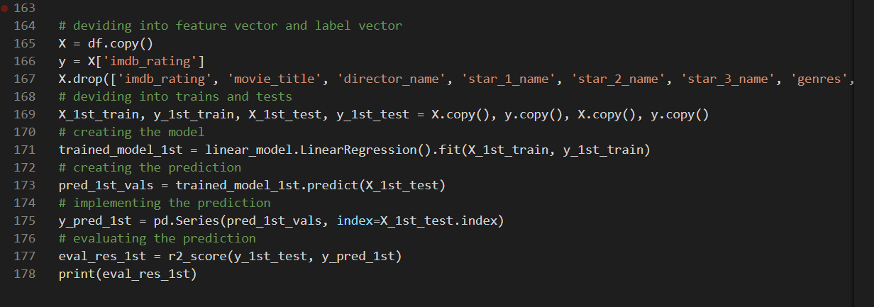
Machine Learning – Linear Regression
The Machine Learning algorithm I used is “Linear Regression”, my label vector is the IMDB rating of the film, because of that I can’t use a classification algorithm, that is why I chose “Linear Regression”.
Data Obtaining
ML
Evaluation
Data Cleaning
EDA

Slide 11

Evaluation
After creating and implementing my model I calculated my R Squared Score, my prediction score ended up as 0.39 which is not a good score, as we learned in class we should expect a score above 0.5.
I started evaluating my model, I removed the outliners that I ignored before only to get a lower score, so I kept them in as I planned from the beginning.
I added a column of binned numbers of voting users which helped raising the score to 0.43.
That still wasn’t enough.
Data Obtaining
ML
Evaluation
Data Cleaning
EDA

Slide 12
Evaluation – Regathering Data And Remodeling
I decided to look for a new source of data, I went back to the IMDB website and decided to create another column using the Metascore score of each film, Metascore is a website that collects reviews of critics about movies, shows and many more.
I initially ignored this value because Meta score is a Sirius website, and I was scared I won’t find scores for many of the films, which would have meant removing a lot of films from my data and affecting badly on my prediction score.
Implementing Metascore score did end up with a lot of Nan values which meant removing a lot of films, but after creating and using the new model I ended up with an R Squared Score of 0.67!
I was right to assume it was possible to predict the score of a film on the IMDB website, I believe my question was answered in my favor.
Data Obtaining
ML
Evaluation
Data Cleaning
EDA

Slide 13
Thank You For Listening!

